Slide 1
Plexus LM PLM Overview
Scott Gai, Erich Ran
May. 2010

Slide 2
LM/PLM processes/components
Tl1agent
  User interface to operate switch (cowork with OMC-P)
DBP (6.x ~ 8.x)
  DB access via ODBC, cross table check
SLAM (6.x ~ 8.x)EMF只是负责把process起来。SLAM是负责交互，TCP，sharememory 各个进程
  Communicate with tl1agent and CLAM to perform the LM functionality
Ccs, Router（最常用）, DBP, MGSIG/M2UASIG, DIST, GDI, SIPCL, IPAGENT, X2SIG (6.x ~ 8.x)
  Envolved from signaling, responsible for call control, provisioning (CLAM), etc.
  Running on SP and CM
Mgsig (6.x ~ 8.x MG, PSG/ISG)强悍的东东，给MG用的。PSG,DSG，
  Communicate with tl1agent to perform the PLM functionality
DB（SQL脚本和replication机制）
  TimesX10 -> MySQL
<number> | Presentation Title | Month 2006

Slide 3
LM/PLM Directories & Build
Tl1agent -> tl1
DBP -> signaling/dbproxy, signaling/lm/dbval
SLAM -> signaling/lm/slam
CLAM -> signaling/lm/clam
Mgsig (6.x ~ 8.x MG, PSG/ISG) -> signaling/tsm/tsmc先看standy by
ENT 先走standby再走active，DLT先走active后走standby
DB -> Db
Build dependcies, example（到signaling build一个单元）
  SLAM depends on telica_common, GU, ga_dev, DB
Build script （build 有depend ）
  /home/xinr/bin/build.sh
  .bashrc alias ‘b=/home/xinr/bin/build.sh’
  b s (a)
<number> | Presentation Title | Month 2006

Slide 4
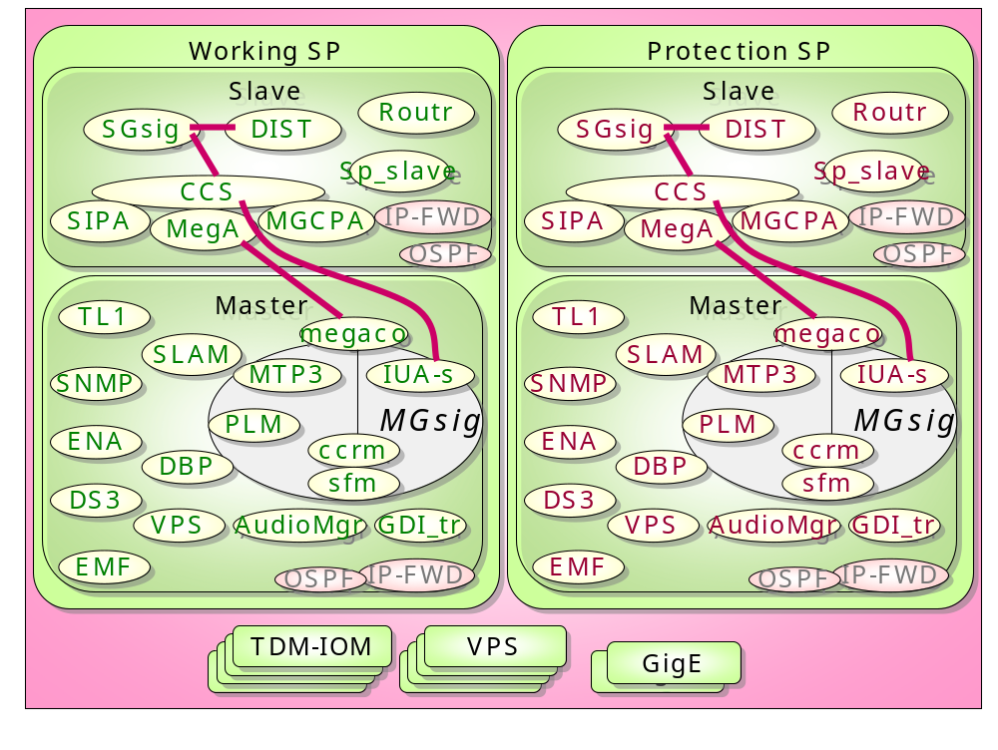
Processes (MG-MGC-SG, LGP)
<number> | Presentation Title | Month 2006

Slide 5
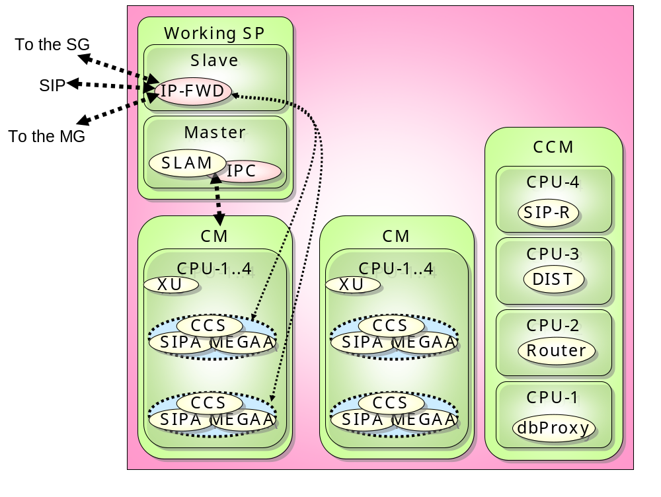
Processes (stand-alone MGC, LGP)
<number> | Presentation Title | Month 2006

Slide 6
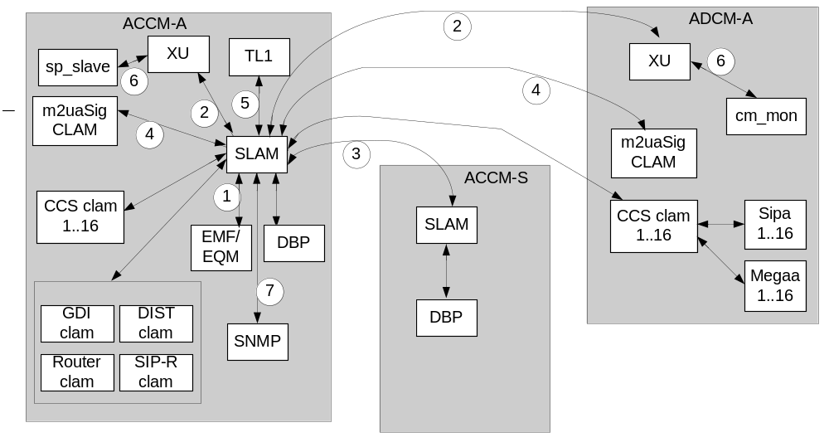
Processes (ATCA, MGC-SG)（LM 相关） ACCM=SP+CCM
<number> | Presentation Title | Month 2006

Slide 7
Functionality of LM/PLM
Path of EMF/TL1/DBP to other applications（Erik理解的lm）
  Provision 下命令
  Validation 保证命令干净合法
  Rewind provision switch restart
  DB access slam ---DBP
  HUG 进程间逻辑协调
  Process State Control EMF物理性的起来，slam控制状态
  Overall Control 打call,CCS起来后把状态告诉SLAM然后告诉其他CCS
  Alarm provision相反，从layer往会clamp 然后到FAM
  PM 手工的监视状态 和RTV类似，但是RTV得数据来自DBP，PM来自CLAM
  Sigdbg 各种Debug命令。
<number> | Presentation Title | Month 2006

Slide 8
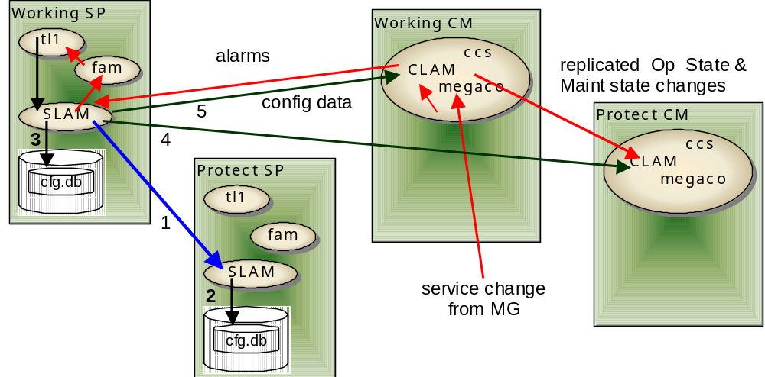
Layer Mgt (SP & CM)
<number> | Presentation Title | Month 2006

Slide 9
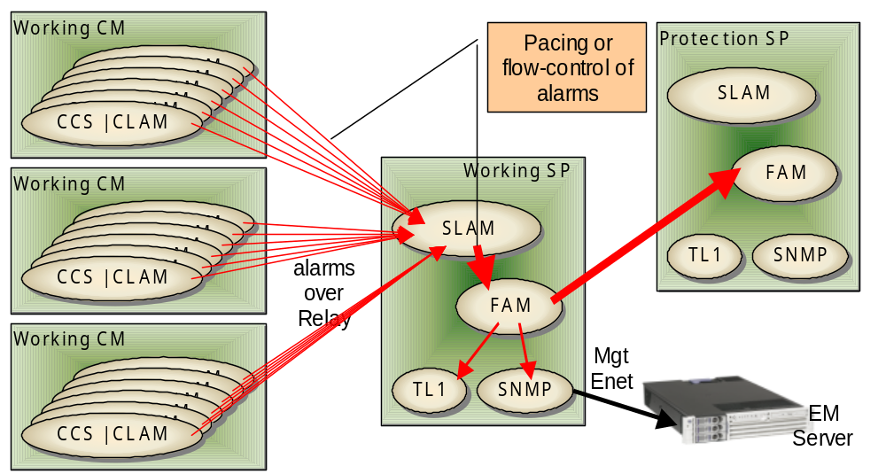
CCS Alarm handling: CLAM->SLAM->FAM
<number> | Presentation Title | Month 2006

Slide 10
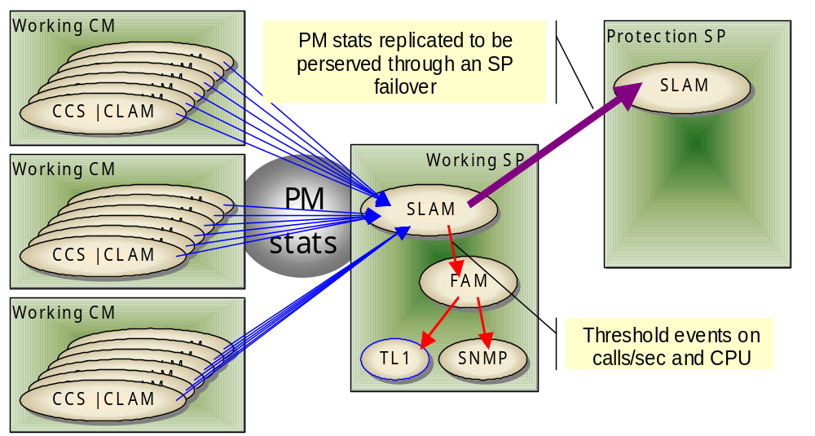
CCS Load Monitoring PM 命令 performance monitor
<number> | Presentation Title | Month 2006

Slide 11
Inter-process Communication 进程通信 和 线程通信
GoAhead (GA) events
  A IPC mechanism based on GoAhead SW architecture
  Process needs to subscribe some events in order to receive the events
    subscribeEvents, SubscribeEvent（一种进程通信的机制，）
  Process will publish events to send message to others
    PublishEvent（TL1 启动时会注册一堆的evt，sendmsg（）把东西发到queue里，然后由main thread 发
  This mechanism is used among emf, SLAM, tl1agent, process running on IOM modules
Relay channel（进程间保持长期的通信，长连接，不同CPU用TCP,同一CPU用share memory ，我们不 care） 比GA 强大
  Based on Trillium（一种架构） SW architecture
  Mainly used by signaling processes, all CLAM processes
<number> | Presentation Title | Month 2006

Slide 12
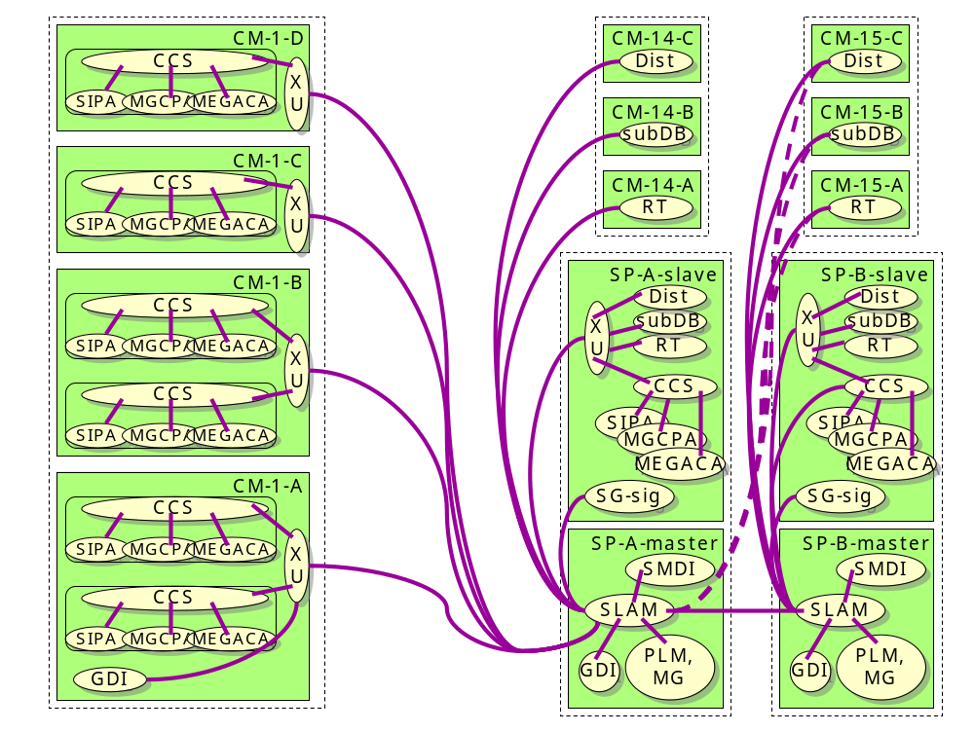
Management relay mesh between processes on different processors/modules (LGP)
<number> | Presentation Title | Month 2006

Slide 13
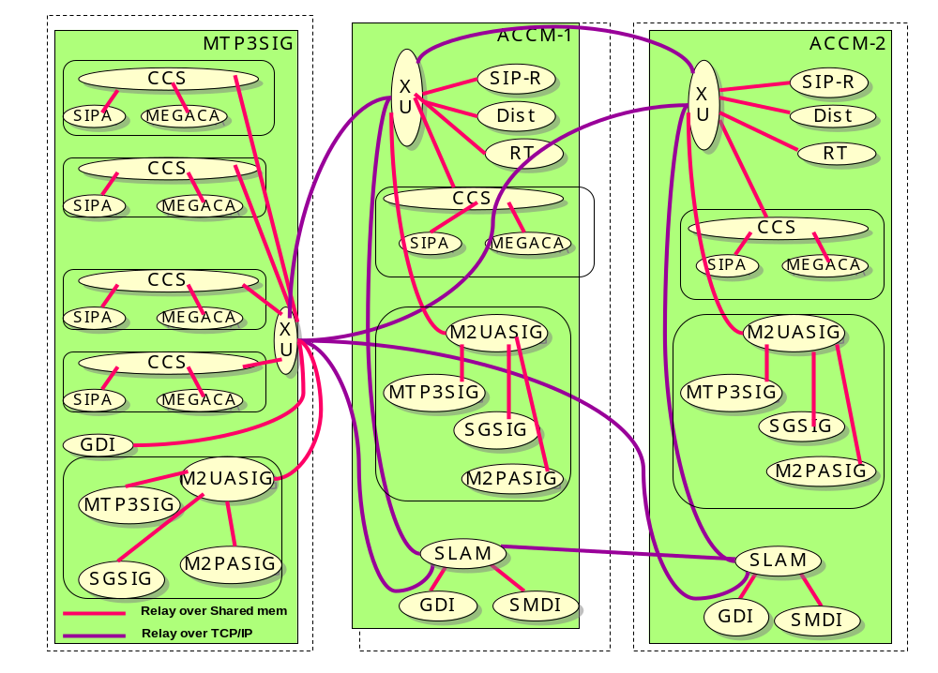
Management Relay Mesh between Processes on different processors/modules (ATCA)
<number> | Presentation Title | Month 2006

Slide 14
Trillium introduction
  Trillium middleware
    Task
      TAPA Task, System Task
      entity, instance, and processor ID
      Generally 1 STsk (thread) to 1 TTsk
      SRegTTsk, SCreateSTsk, SAttachTTsk
      tst, osCp, SRegActvTsk, SRegInit, xxActvTsk, xxActvInit
      ry_config
    Message sl_main.c(slam 的启动函数 slActvTsk slam的回调函数，slam的函数都从这里看先active 再init)
      Post Structure, SPstTsk
      SGetMsg/SPutMsg, PK/UNPK, SAddPstMsgMult/SRemPstMsgMult
    Memory
      SGetSBuf/SPutSBuf
    Timer （看看谁用的 ，怎么用的）
      SRegTmr, SDeregTmr, xxActvTmr
      cmPlcCbTq, cmRmvCbTq, cmPrcTmr
<number> | Presentation Title | Month 2006

Slide 15
Entity inside of SLAM
SLAM performs its function in the form of many entities
  It will register many entities during initialization period
  Those entities will be designated to run on master processor
  One (generally) or more entities（Tapatask） will be attached on a thread. And each thread has its own thread queue
  An entity named ENTSLM is registered
    LM module resides in this entity
  Another entity named ENTGA is also registered
    This entity is responsible for receiving message from other entities and publish the message to TL1/EMF
<number> | Presentation Title | Month 2006

Slide 16
ENTSLM & ENTGA
SLAM
Events from other GA processes
ENTGA
Other entities
Events to other processes
Events to other GA processes
SLM
LM
Module 1
Module 2
Module 3
<number> | Presentation Title | Month 2006

Slide 17
TL1agent 没有entity
Not based on Trillium
Pthread, OAL wrapper
Gencode, Common, Telcode, User_impl
Listen port 2361, 2362, 2363
main()
lumos_multi_thead()
InitThreads // watchdog, exec, aomsg, etc
eosl_thread_create( listen_loop, 0, (void *)&ports[i] );
listen_loop() // bind, listen, accept
eosl_thread_create( main_loop, ...)
main_loop(arg)
<number> | Presentation Title | Month 2006

Slide 18
TL1 Command
Three categories:
  EMF
    TL1 ----GA----> EMF
  SLAM/CLAM
    CLASS1, 2, 3
    TL1 ----GA—→ SLAM ----RY—→ CLAM —→ Layer
    HUG
  TL1
    User-secu, act/canc-user
    EXEC (ie. Exec-ftp-logs) 调用脚本只有一条exec命令
Hybrid
    Ed-sys-secu
<number> | Presentation Title | Month 2006

Slide 19
Backup - FSM implementation
CmFsmStateInfo, CmFsmEventInfo,
CmFsmRow slBrdFsmMt[SLBRD_ST_MAX][SLBRD_EV_MAX] = {
/* SLBRD_ST_OOS */
{
{brd_oos_eqm_oos, SLBRD_ST_FN_DEFD}, /* SLBRD_EV_EQM_OOS */
{brd_oos_eqm_is, SLBRD_ST_FN_DEFD}, /* SLBRD_EV_EQM_IS */
{brd_unexpected_ev, SLBRD_ST_FN_DEFD}, /* SLBRD_EV_EQM_FSO */
{brd_unexpected_ev, SLBRD_ST_FN_DEFD}, /* SLBRD_EV_PTR_HOT */
{brd_unexpected_ev, SLBRD_ST_FN_DEFD}, /* SLBRD_EV_PTR_COLD */
{brd_unexpected_ev, SLBRD_ST_FN_DEFD}, /* SLBRD_EV_CLAM_READY */
{brd_unexpected_ev, SLBRD_ST_FN_DEFD}, /* SLBRD_EV_CLAM_SYNCED */
{brd_unexpected_ev, SLBRD_ST_FN_DEFD}, /* SLBRD_EV_CLAM_RCVRD */
{brd_ignore, SLBRD_ST_FN_DEFD}, /* SLBRD_EV_CLAM_OOS */
},
/* SLBRD_ST_ACT_STANDALONE */
… …}
cmFsmCpInit, cmFsmInstInit, cmFsmQueueEvt, cmFsmSetState
<number> | Presentation Title | Month 2006

Slide 20
Backup - FSMs
SLAM TL1 FSM
  SLAM unit FSM
SLAM init FSM
SLAM FTH FSM
SLAM Board FSM
SLAM CLAM FSM
CLM FSM
<number> | Presentation Title | Month 2006

